Slide 1
UNIVERSITY RESULT MANAGEMENT SYSTEM
PRESENTED BY MD HABIBUL BASHER SAIKAT, SAKIB
CHOWDHURY,ZARIN

Slide 2




PRESENTATION OUTLINE
Abstract Introduction Objective Methodology System Output Conclusion

Slide 3

ABSTRACT
The "University Result Management System" aims to streamline the process of managing student results within a university setting and the primary goal of this project is to create an integrated platform that facilitates the management of university results while enhancing transparency, accessibility, and accuracy.

Slide 4

INTRODUCTION
Our project revolutionizes record-keeping and result management by replacing traditional paper-based systems with a modern, efficient, and transparent platform. With three panels for Admins, Teachers, and Students, we aim to enhance the educational experience. Our primary objectives are Efficiency, Transparency, User- Centricity, and Reliability, driving the future of academic data management.

Slide 5

OBJECTIVE
To automate and streamline the process of course assignment, user creation, and student result management for administrators.
To empower teachers with a user- friendly interface for viewing their proﬁles, assigned courses, and recording course marks.
To provide students with easy access to their proﬁles and individual course marks, promoting transparency and accountability.

Slide 6

METHODOLOGY
PANEL
-> Admin
-> Teacher
-> Student

Slide 7


ADMIN PANEL
Create New User (Teacher and Student)
View registration
info(Teacher and Student) Assign Course to Teacher View results of all student

Slide 8

TEACHER PANEL
View his Profile
View his assigned Courses Enter Marks individual student

Slide 9



STUDENT PANEL
View his Profile
View his individual Course Result

Slide 10

SYSTEM OUTPUT
Fig-1: Home Page
This page have some section like Home, About, Teacher Signup, Student Signup, Login. Also have some card, Title and some paragraph.

Slide 11
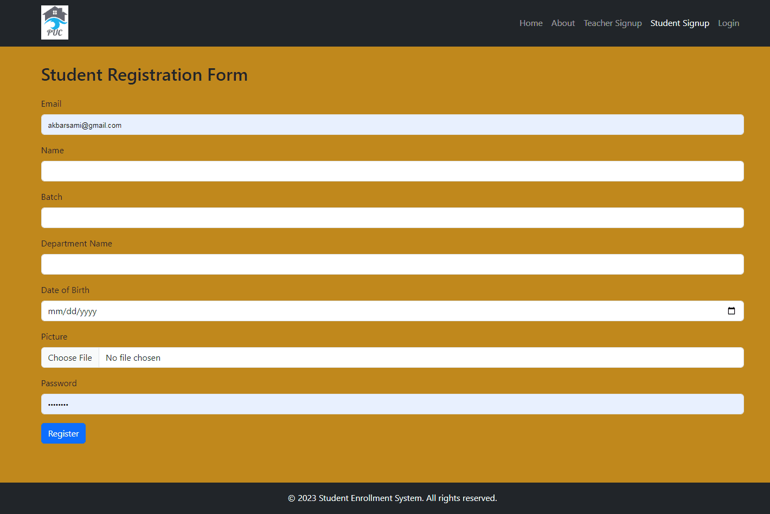
Fig-2: Student SignUp
Here some field for signup or registration a student. Fields are Email,Name,Batch,Department Name,Date of birth,Picture,Password.

Slide 12
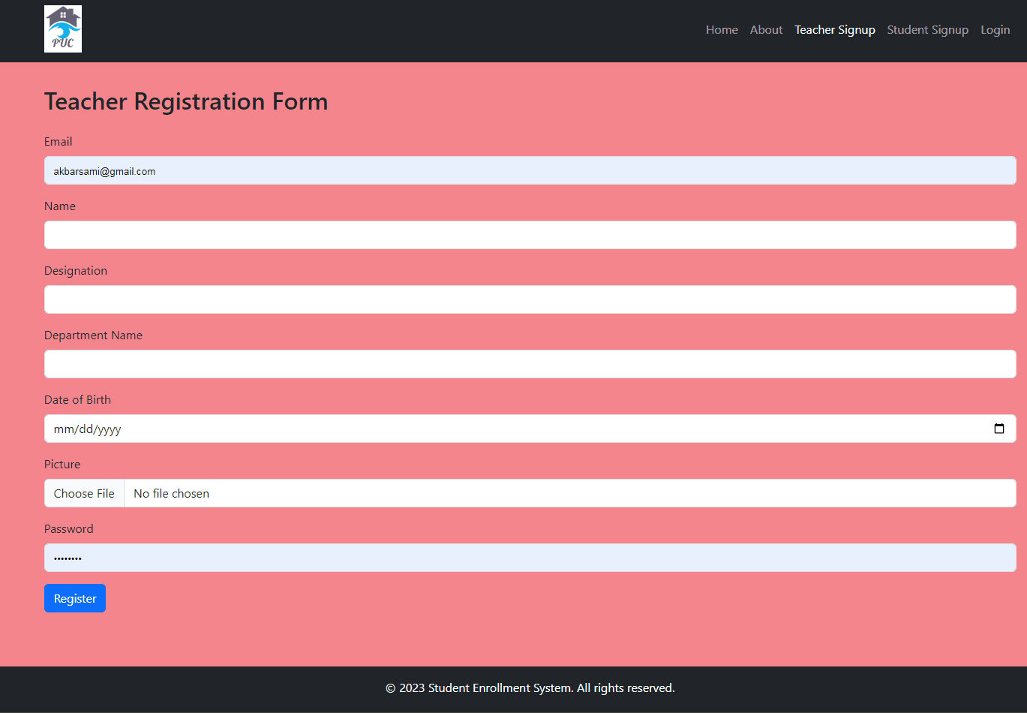
Fig-3: Teacher Sign Up
Here some ﬁeld for signup or registration a teacher. Fields are Email, Name, Designation, Department Name, Date of birth, Picture, Password.

Slide 13
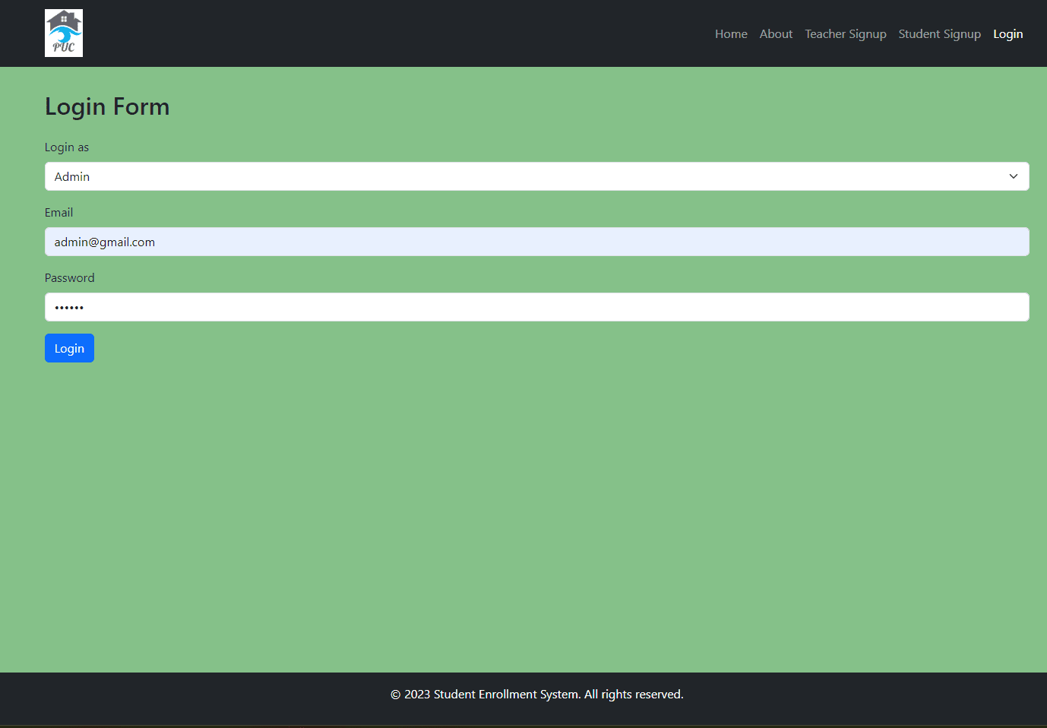
Fig-4: Login Page Here 3 option for login like admin,teacher and student.

Slide 14
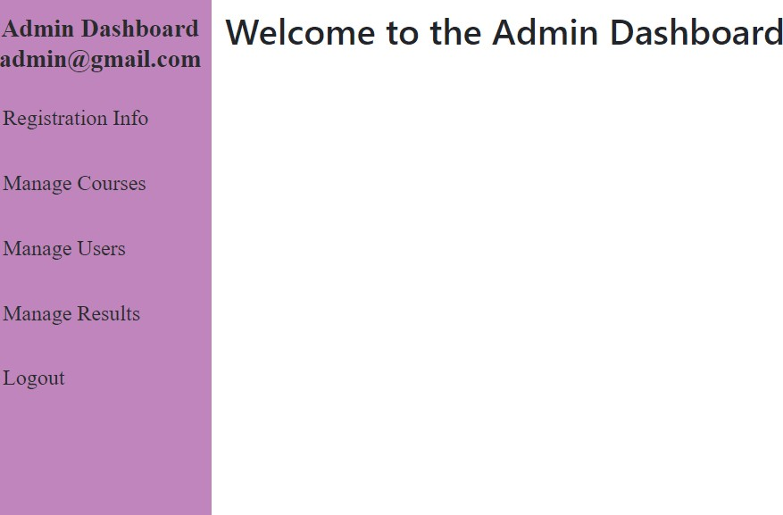
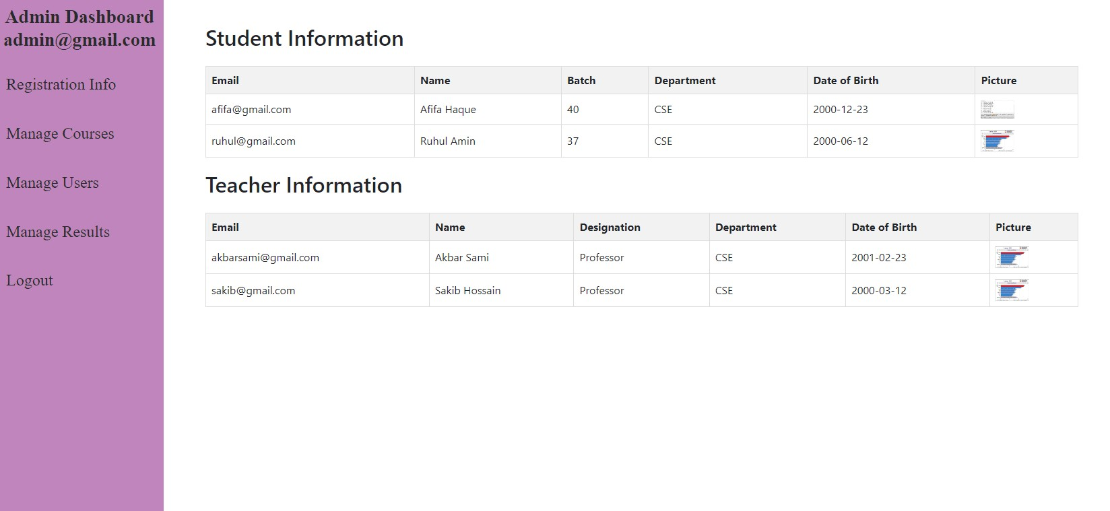
Fig-5: Admin Dashboard
.
Fig-6: Admin RegistrationInfo
.

Slide 15
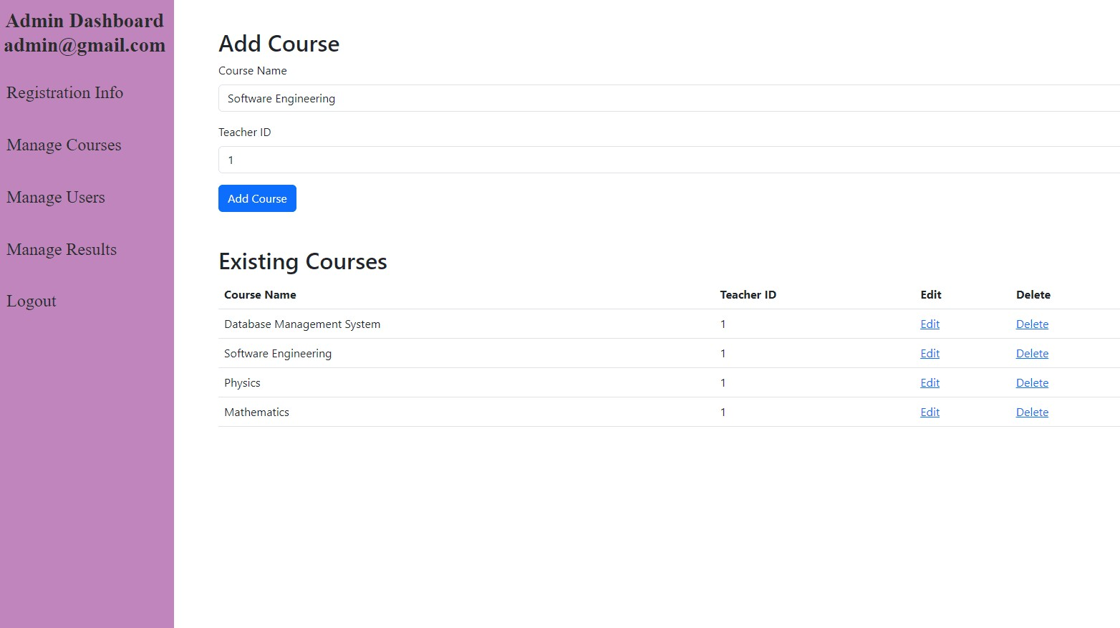
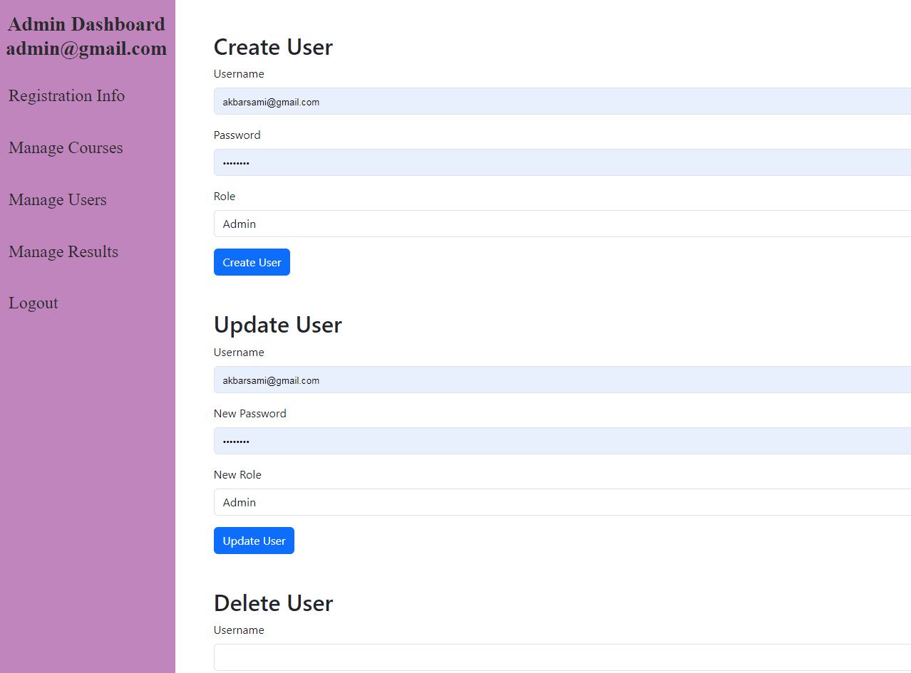
Fig-7: Admin Manage Course
.
Fig-8: Admin Manage User
.

Slide 16
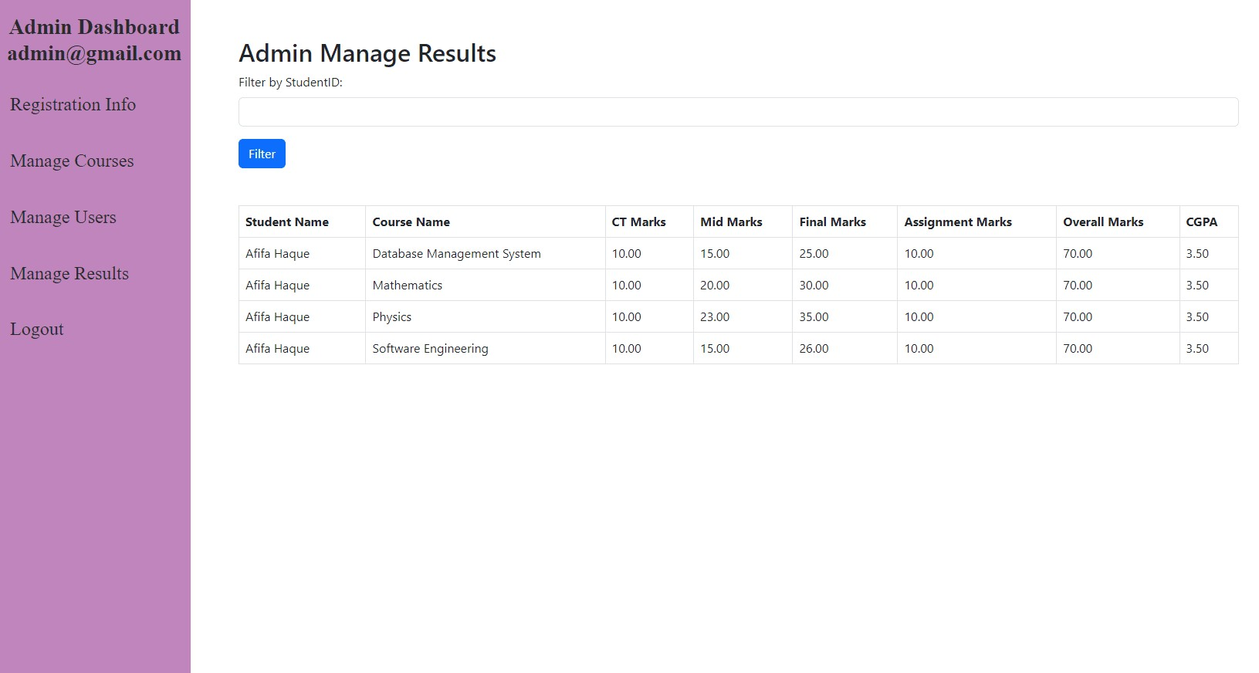
Fig-9: Admin View Result
.

Slide 17
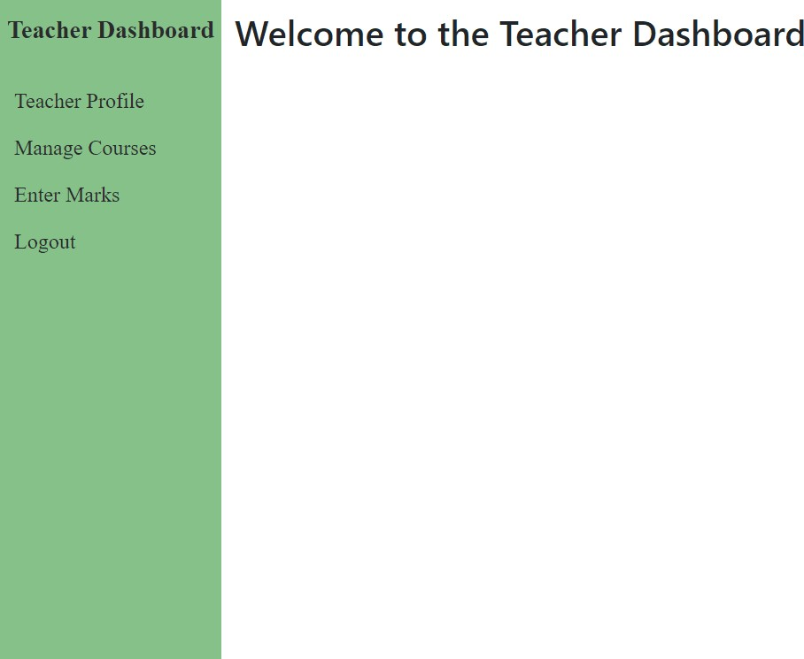
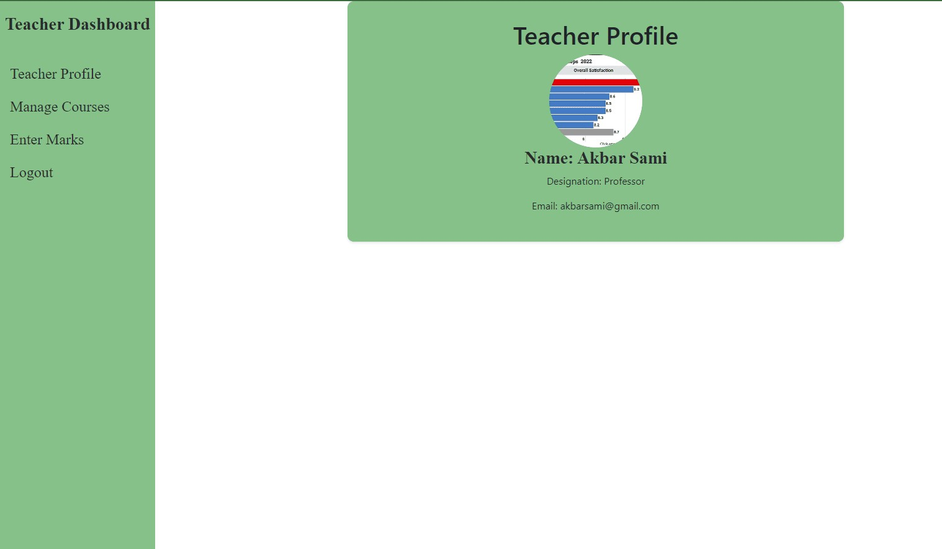
Fig-10: Teacher Dashboard
.
Fig-11: Teacher Proﬁle

Slide 18
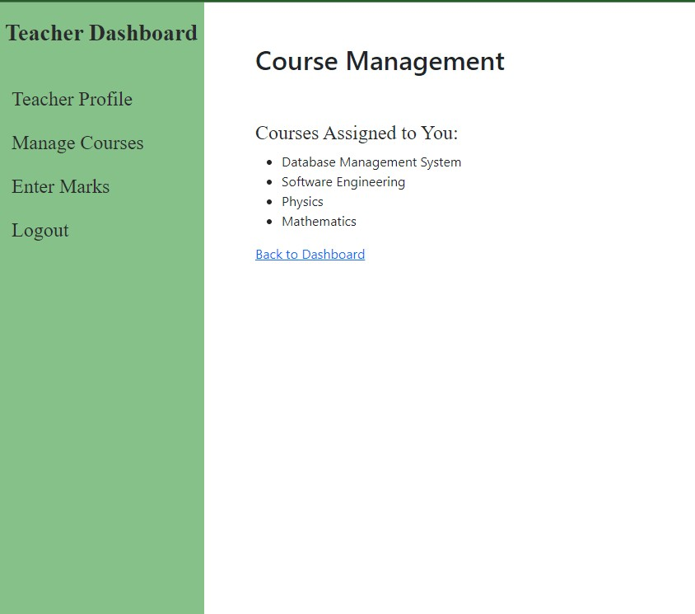
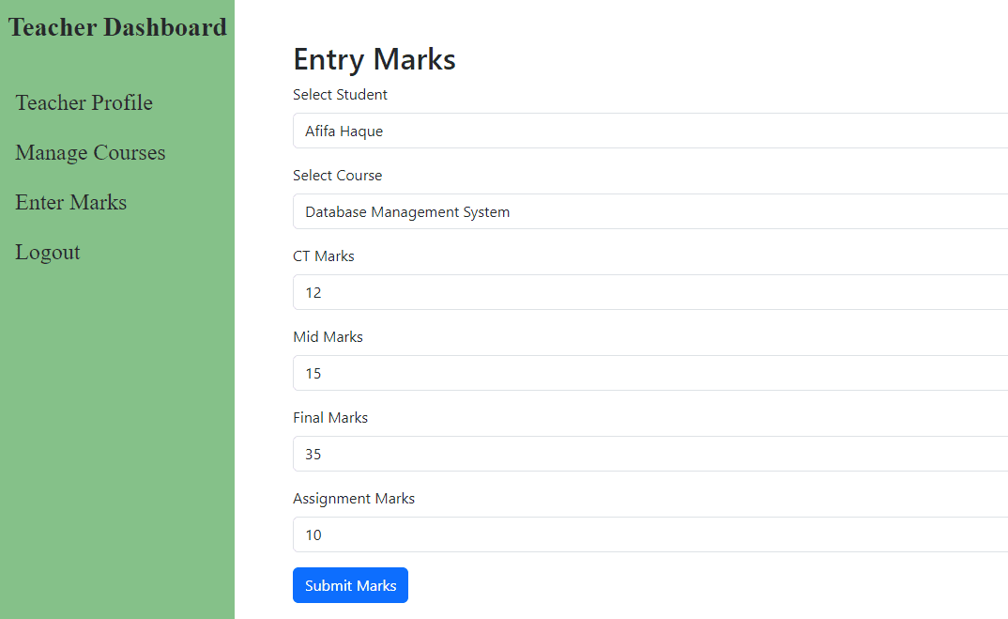
Fig-12: Teacher View Courses
.
Fig-13: Teacher Enter Marks
.

Slide 19
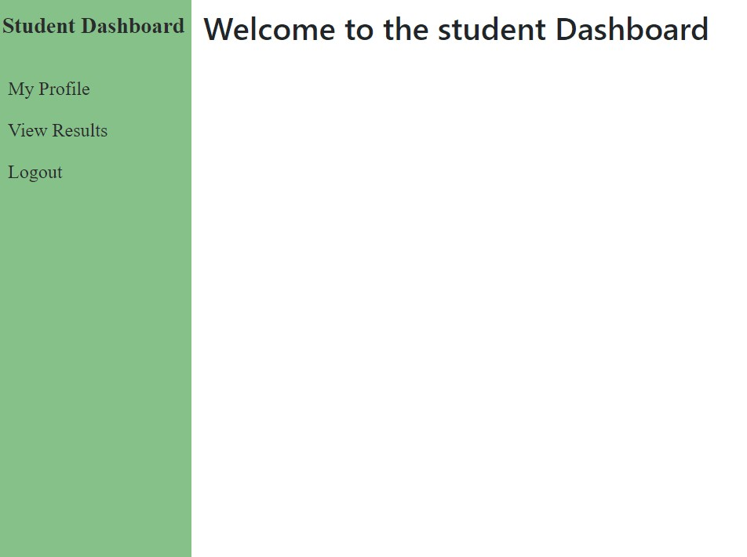
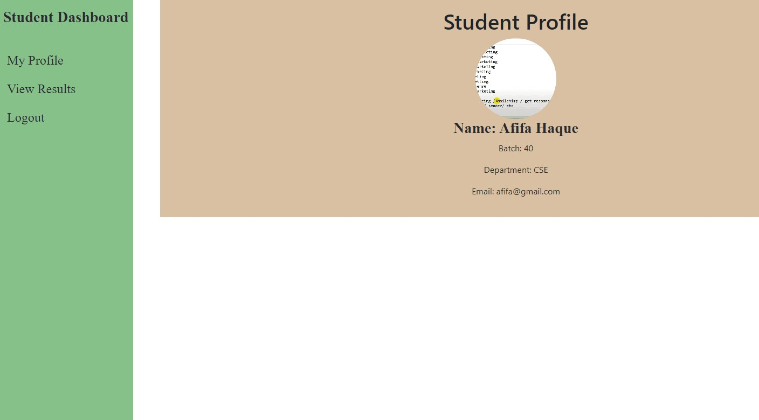
Fig-14: Student Dashboard
.
Fig-15: Student Proﬁle
.

Slide 20
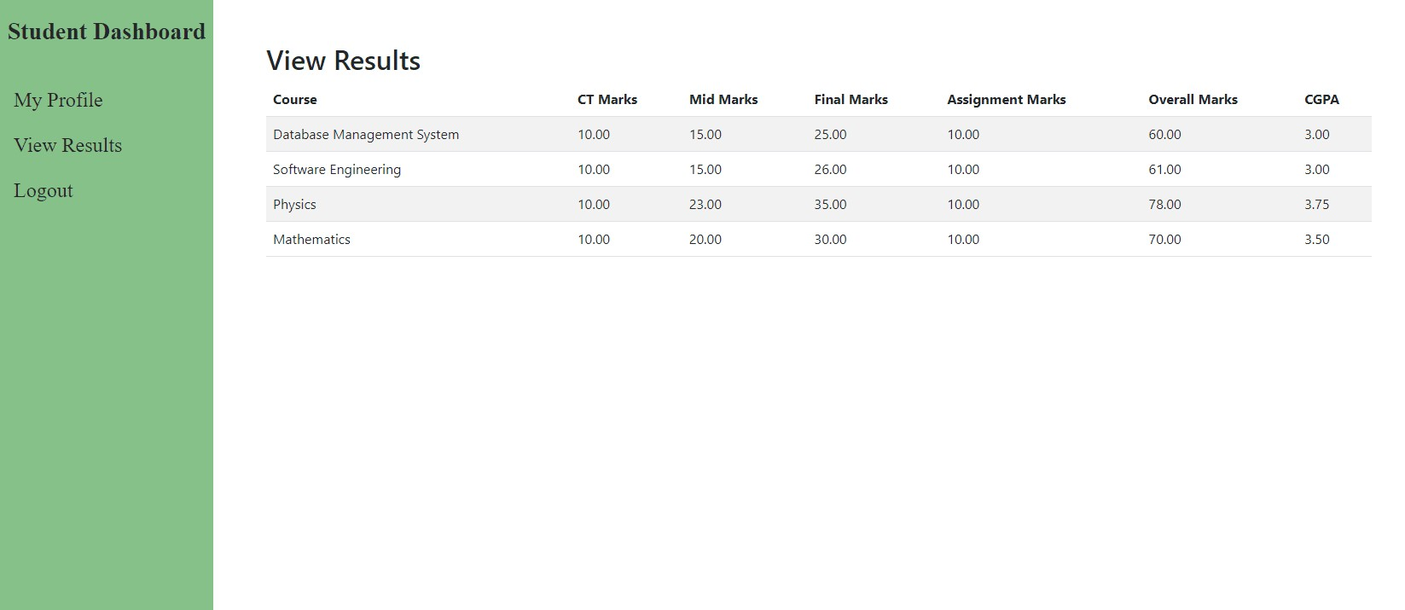
Fig-16: Student View Result
.

Slide 21

CONCLUSION
In this project, I have established the essential relationships between the tables in your database based on the provided scenarios. These relationships facilitate the management of data and interactions between admins, teachers, and students in a coherent manner. By structuring the database in this way, you can efﬁciently assign courses, manage user proﬁles, and record and access academic results, contributing to a streamlined and organized educational management system.

